Slide 1
Unsupervised Learning
MANIFOLD SCULPTING

Slide 2
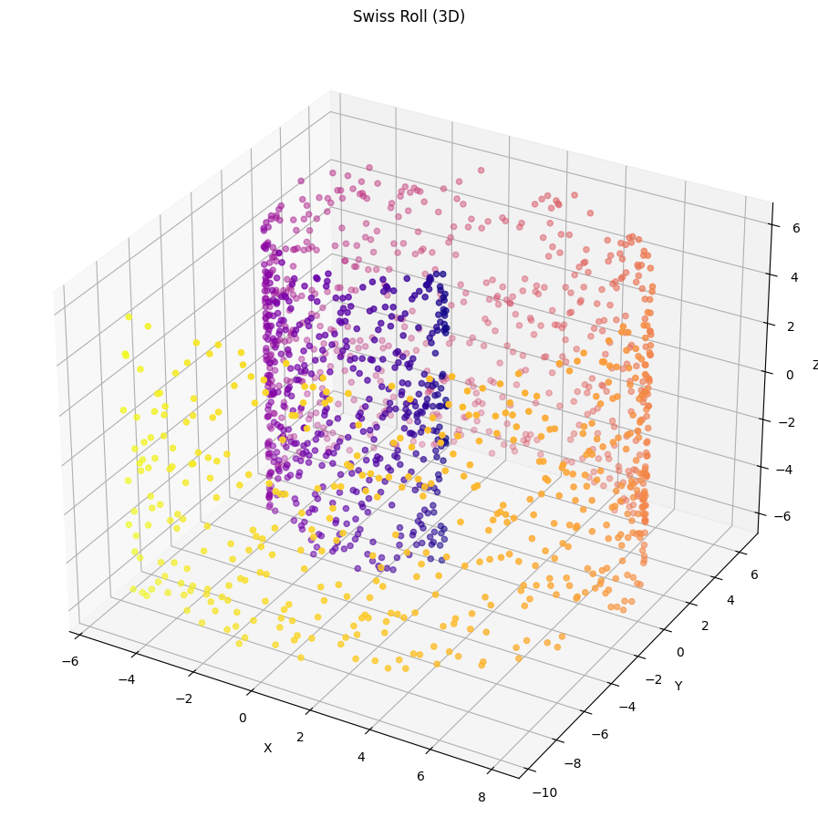
The method
Iterative Non-linear dimensionality reduction
Balance that preserves information in the transformation without losing it in the projection
Process of progressive refinement, transforming data with 2 heuristics:
  Scale information out of unwanted dimension
  Preserve local structure

Slide 3
The Algorithm
Find the k nearest neighbors of each point
Compute relationships between neighbors:
  Distance
  Angle
  Global average distance δ_{ave}
PCA : compute first |D_{pres}| PC in the data and rotate
Transform the value while the stopping criteria has not been met:
  Scale the data in the non-preserved dimension |D_{scal}|
  Restore original relationships
Project the data, by dropping the unwanted dimensions

Slide 4
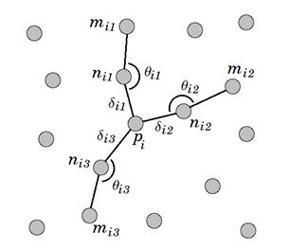
Compute relationship between neighbors
  Euclidean distance δ_{ij} between p_{i} and each n_{ij} ∈ N_{i}
  angle θ_{ij} formed by the two-line segments (p_{i} to n_{ij}) and (n_{ij} to m_{ij})
    where m_{ij}: most collinear

Slide 5

Restore original relationships
Optimization with an heuristic error, to adjust points:

Slide 6
Parameters
K Number of Nearest Neighbors
Stopping criterion: change in error and patience
σ= scale factor 0 < σ < 1
Learning rate (minimization step for hill climbing process)

Slide 7
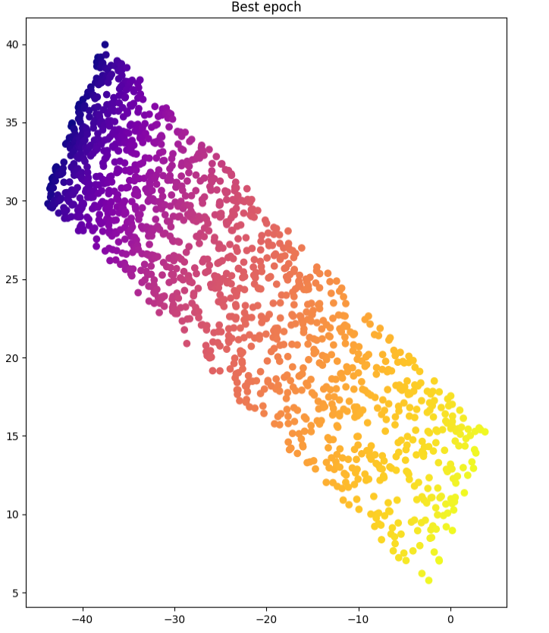
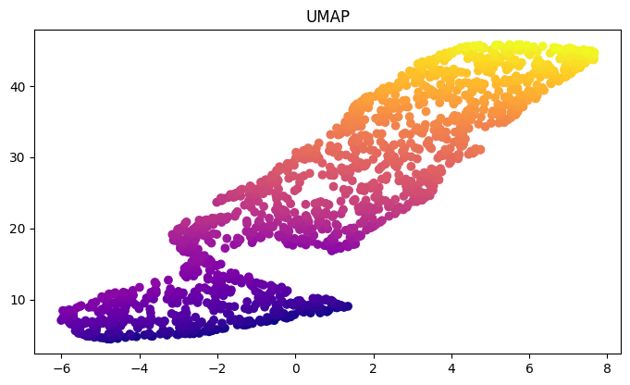
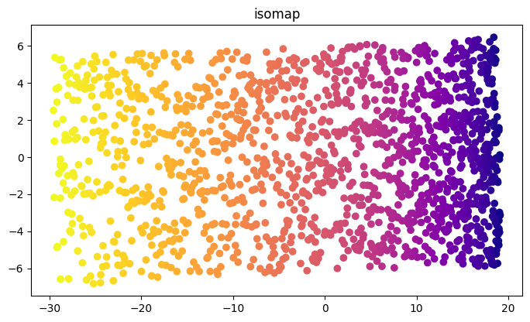
Results
MS: balance between preserving global structure (the overall shape) and local details
ISOMAP: excellent at representing the global layout of the data but tends to compress local variations
UMAP: preserving local relationships (nearby clusters remain intact) but sacrifices global precision

Slide 8
Conclusions
Advantages:
  Balanced Preservation of Global and Local Structure
  Adaptability to Complex Manifolds
  Accurate
Disadvantages:
  Possible convergence to local minima
  Difficult Tuning
  Possibly slow

Slide 9
Thank you

